Slide 1
From the Universe to Goodhue
exploring outer space to where we are

Slide 2
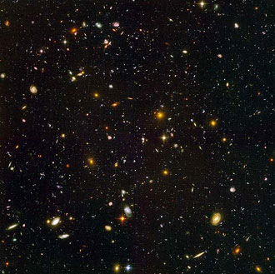
The Universe
“The universe is commonly defined as the totality of everything that exists, including all physical matter and energy, the planets, stars, galaxies, and the contents of intergalactic space”

Slide 3
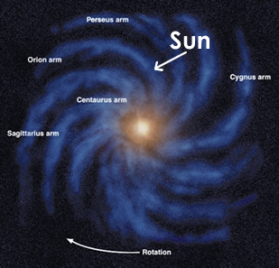
Milky Way Galaxy
Our solar system is part of the Milky Way Galaxy.
The milky way galaxy contains millions of different stars, including ours, the sun.

Slide 4
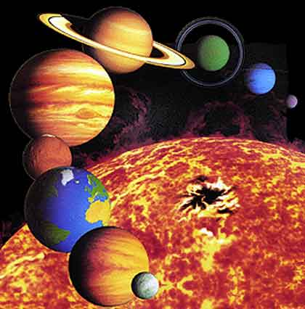
Solar System
The solar system describes the planets and other matter that orbits the sun.
The sun is the prime source of energy for our solar system.

Slide 5
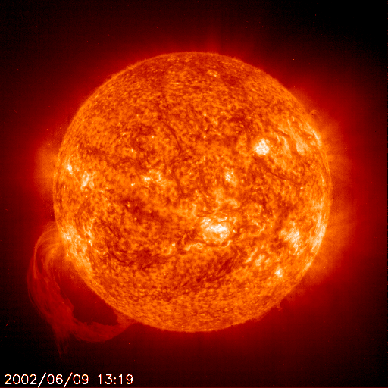
The Sun
The sun contains 99% of the mass of the solar system.
The sun is made up of mostly hydrogen and helium (98%), the rest is made of metal
Energy given off by the sun is due to nuclear fusion

Slide 6
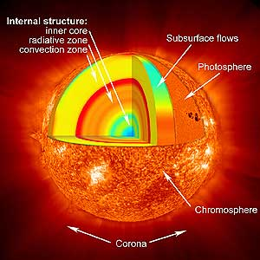
The Sun
Over 1 million Earth’s would be needed to fill the sun
The outer layer of the sun is about 11,000 degrees Fahrenheit (even hotter in the middle)
http://video.nationalgeographic.com/video/player/science/space-sci/solar-system/sun-101-sci.html
http://science.discovery.com/videos/space-school-the-sun.html

Slide 7
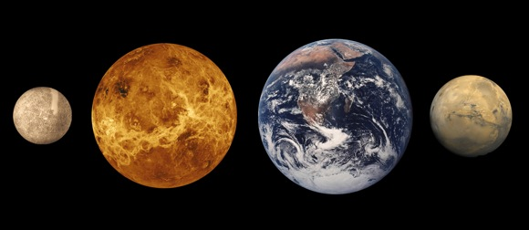
The Terrestrial Planets

Slide 8
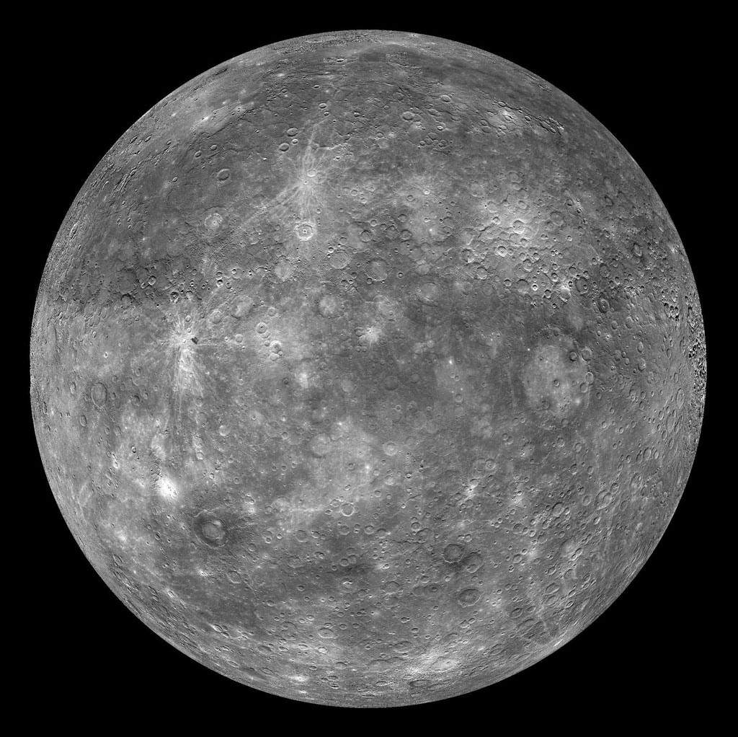

Slide 9
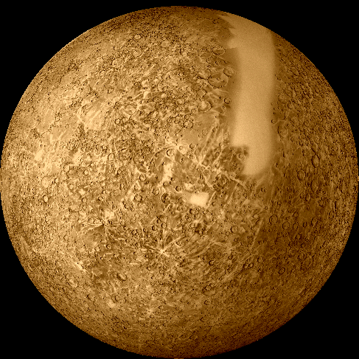
Planet Profile: Mercury
Smallest and innermost planet
Orbit is every 88 days
Made of a lot of oxygen, hydrogen and salt
No substantial atmosphere and resembles the moon

Slide 10
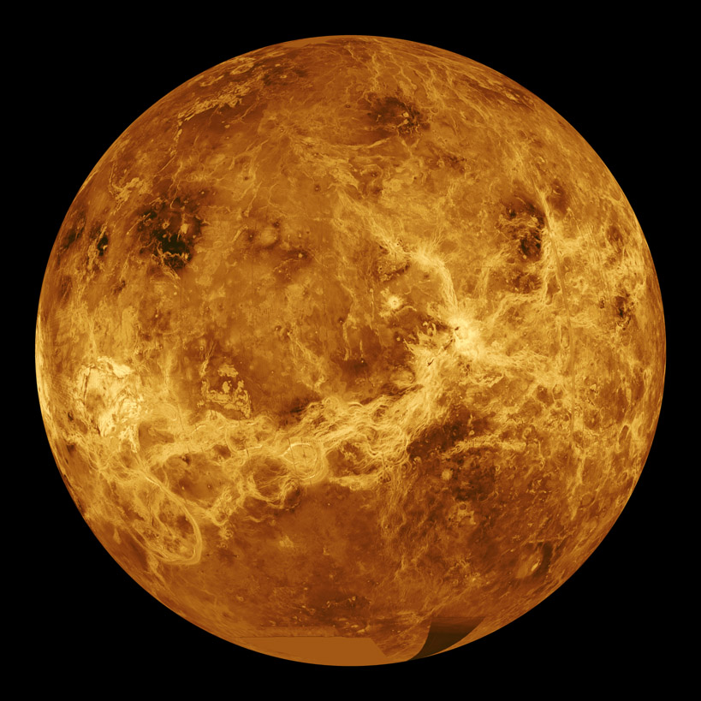

Slide 11
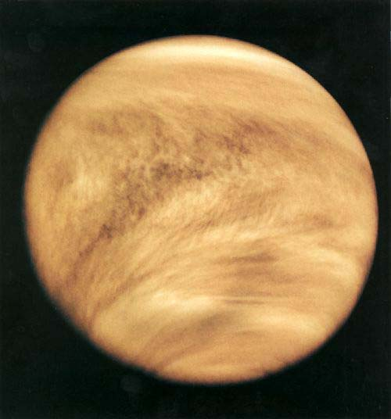
Planet Profile: Venus
2nd planet from sun, orbits every 225 days
After the moon, it is easiest planet to see at night
Sometimes called “Earths Sister” because it is same size and shape
Carbon dioxide atmosphere is 97% Carbon dioxide!

Slide 12
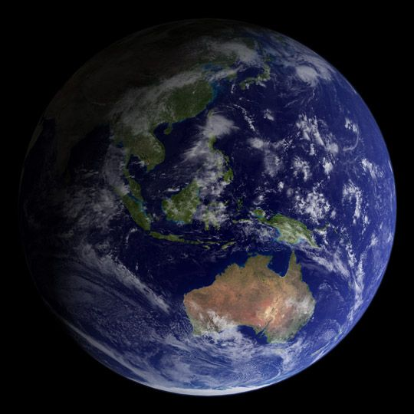

Slide 13
Planet Profile: Earth
3rd planet from the sun, orbit the sun every 365 days, 5th largest
Called “the blue planet” because it is covered by 70-percent water
Only planet in solar system that we know has been able to support life

Slide 14
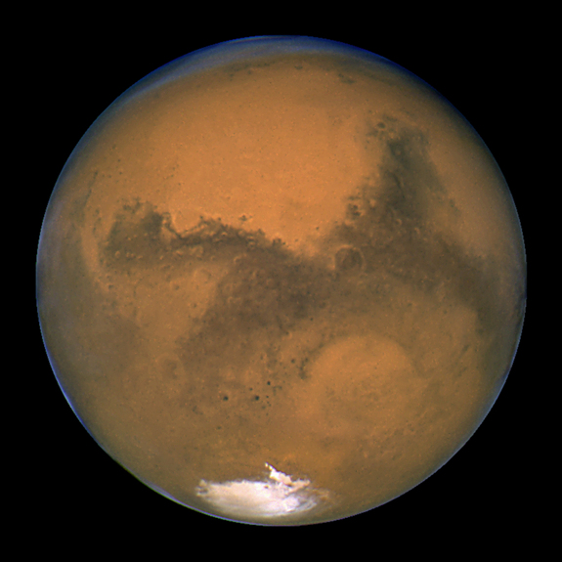

Slide 15
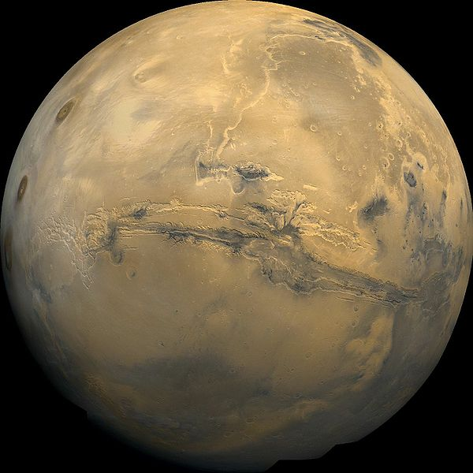
Planet Profile: Mars
4th planet from the sun, 2nd smallest
It is reddish because of the rust that occurs on the surface of rock (basalt)
Has two moons: Phobos and Diemos
Has frozen water, possibility that life is or was once there

Slide 16
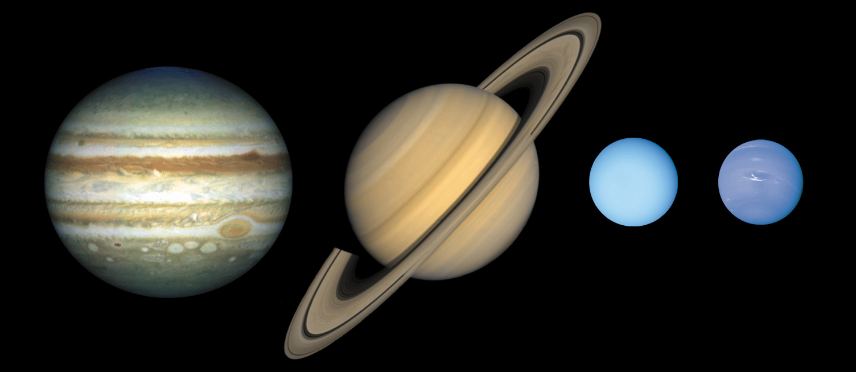
The Jovian Planets Gas Giants

Slide 17
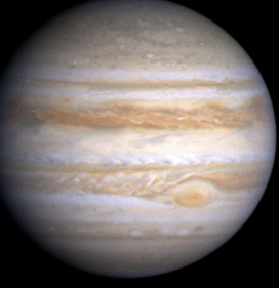

Slide 18
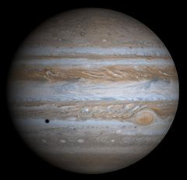
Planet Profile: Jupiter
5th from the sun, the largest planet in the SS
It is extremely massive, 2.5x mass of all planets combined
Is made up of mainly hydrogen and helium
Has over 63 moons orbiting around it
Giant red spot is actually a large hurricane that has lasted for at least 200 years

Slide 19
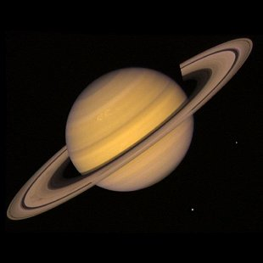

Slide 20
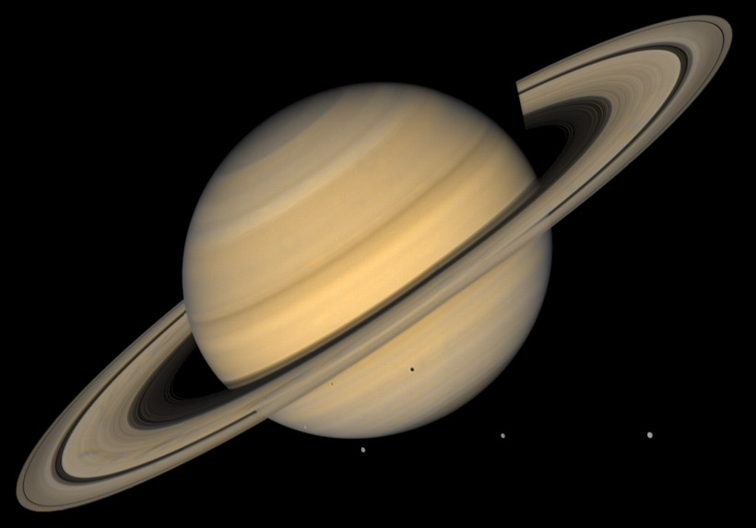
Planet Profile: Saturn
Saturn has over 50 moons
Titan is one of the most popular moons, 2nd largest
The rings are made up of thousands of tiny ice, dust and other particles
Very low density compared to other planets

Slide 21
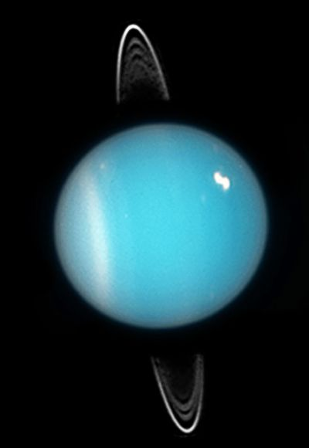

Slide 22
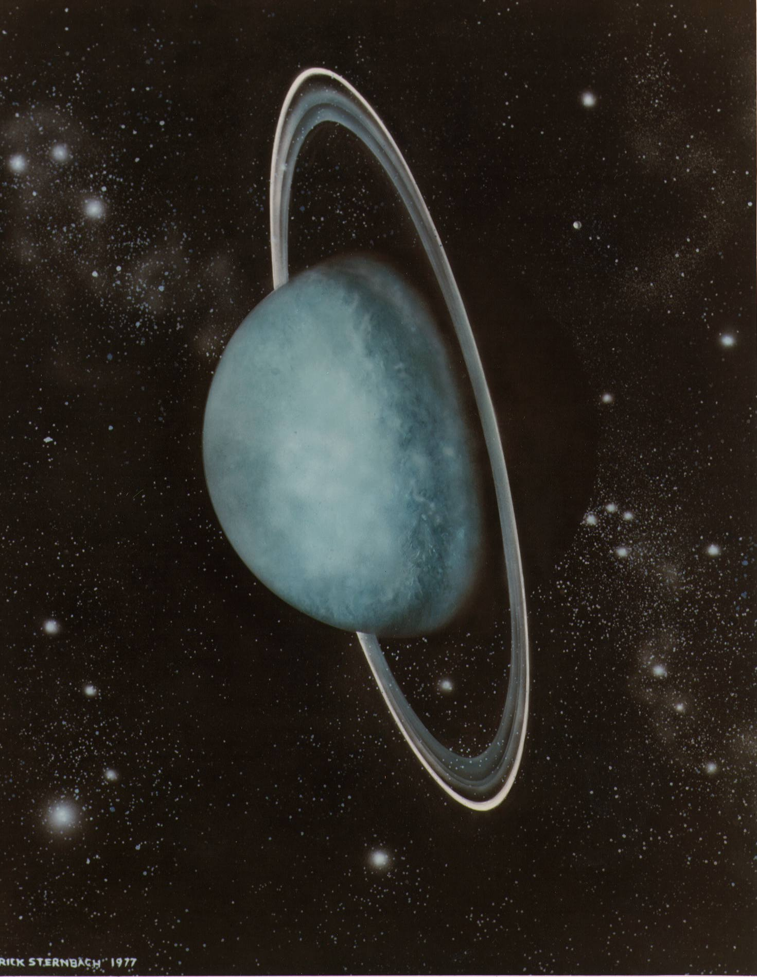
Planet Profile: Uranus
7th from the sun
Extremely cold, average temp is -350 degrees F
Made up of ammonia and methane which makes it appear bluish color
Tilts at an extreme axis compared to other planets
Also has small rings of ice particles

Slide 23
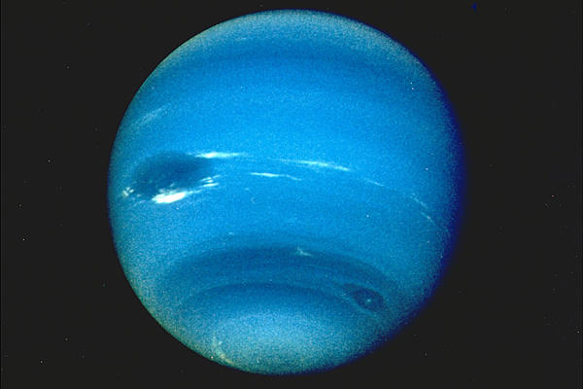

Slide 24
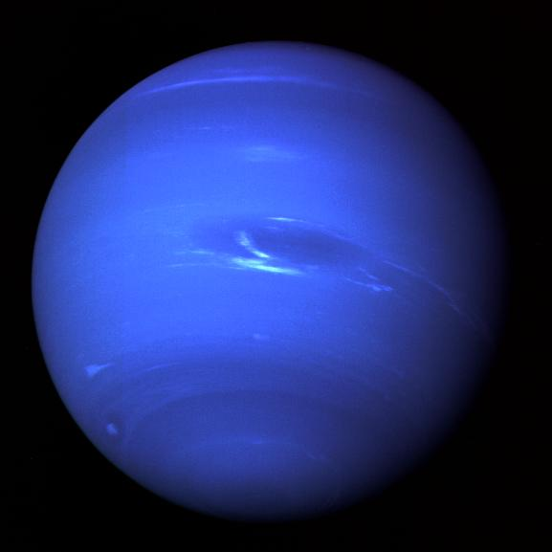
Planet Profile: Neptune
8th planet from the sun, our last planet
Has a rocky inner core that is about the size of our Earth
Surface of Neptune has very high winds and disastrous storms
Also has a high amount of methane that makes it appear a blue color

Slide 25
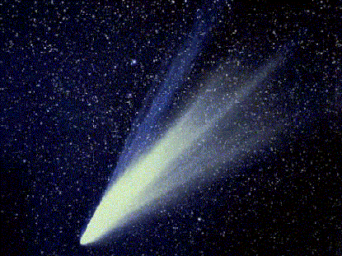
Comets
“Dirty snowball”
Chunks of ice and dust whose orbits are usually very long, narrow ellipses
They have a very pronounced tails which is solar winds pushing the gas from the comet
http://www.youtube.com/watch?v=iHeklbuyBSs&safety_mode=true&persist_safety_mode=1&safe=active

Slide 26
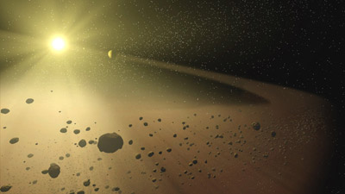
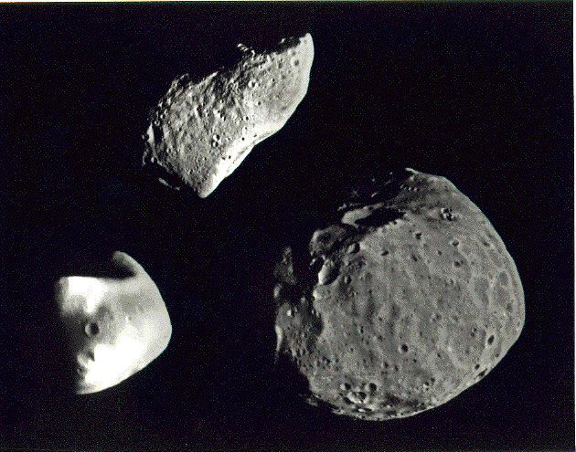
Asteroids
Chunks of rock and other materials that revolve around the sun
The area between Mars and Jupiter is called the asteroid belt.
http://www.youtube.com/watch?v=KniNxDo5ycQ&safety_mode=true&persist_safety_mode=1&safe=active

Slide 27
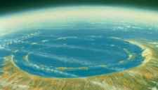
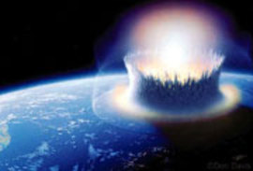

Slide 28
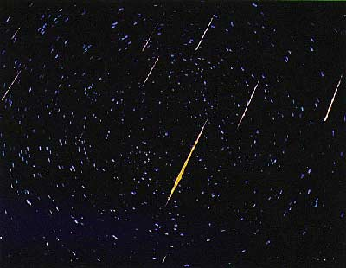
Meteors
Meteroids are chunks of rock or dust that usually come from asteroids or comets.
When a meteor enters Earth’s atmosphere the friction produces a streak of light called a meteor.
http://www.youtube.com/watch?v=KLM1pfgv9IE&safety_mode=true&persist_safety_mode=1&safe=active

Slide 29
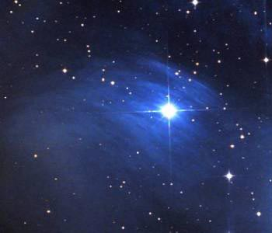
Stars
A star is a massive, luminous ball that produces light by nuclear burning
The sun is our closest star, but is one many.

Slide 30
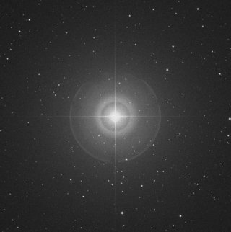
The Northern Star
A visible star that is approximately aligned with the Earth’s rotation
Was used as a main point in early navigation

Slide 31
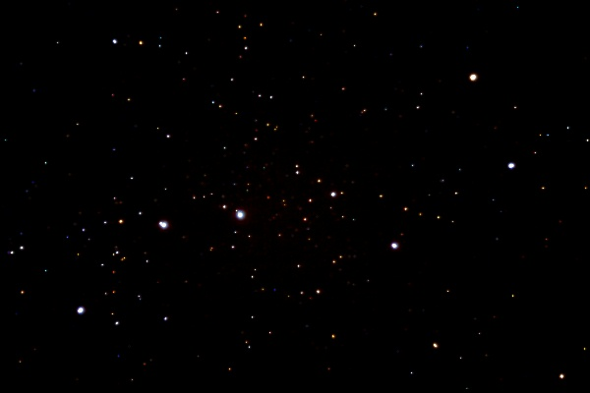
The Big Dipper

Slide 32
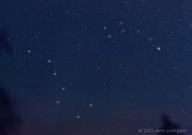
The Big and Little Dipper

Slide 33
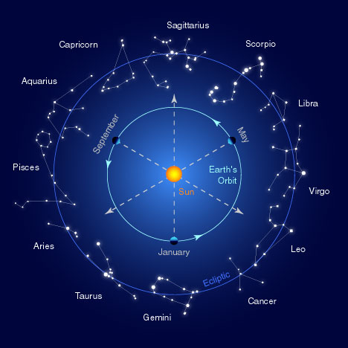
Constellations

Slide 34
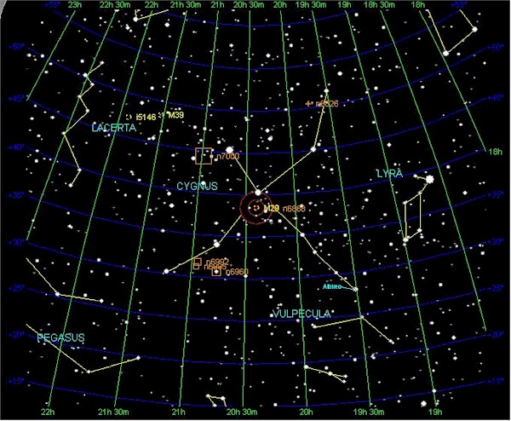
Constellations

Slide 35
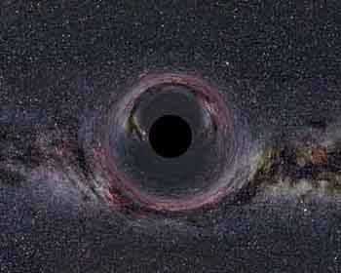
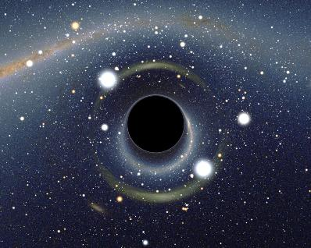
Black Holes
A black hole is a region of space from which nothing, not even light, can escape. The theory of general relativity predicts that a sufficiently compact mass will deform space time to form a black hole.

